Slide 1

Master Your Data using MDS
Boston BI User Group – Jan 24, 2018
Beth Wolfset, Data Architect Email: beth.wolfset@insight.com
Twitter: @beth_wolfset
Notes:
Presentation also given at:
SQL Saturday Albany – July 29, 2017
SQL Saturday Providence – December 9, 2017
Version of this presentation for developers presented at:
Boston Code Camp – October 2017

Slide 2
About BlueMetal, a Division of Insight
Modern technology, craftsman quality.
We’re an interactive design and technology architecture firm matching the most experienced consultants in the industry to the most challenging business and technical problems facing our clients. Founded August 2010 and as of October 2015 we are an Insight company.
6 | YEARS IN OPERATION 5 | LOCATIONS 6 | SERVICE AREAS
4 | INDUSTRY SPECIALIZATIONS
Notes:
Locations: Boston, New York, Chicago, DC, Tempte
Service Areas:
Intelligent Customer Applications
Modern Business Applications
Real-Time Business
Hybrid Cloud
Modern Workplace
Branch Infrastructure

Slide 3

Topics
Current Issues
Identifying data to Master
Overview of MDS
Methods of Mastering Data
Tools
Take me to your Data!

Slide 4

Current Issues
CHAOS
Inconsistent definitions and usage across systems
Duplicated efforts
Data pulled from different sources
Bad or missing data
AHEAD
How many orders were placed yesterday

Slide 5

Identifying Common Data Objects
Across systems, similar objects are manifested with different data structures.
Logs
Taxonomies &
Reference Data
Events
Auditing
Business Objects
Demographic Data
Utilization
Notes:
When the same objects is represented different ways, it is difficult to get a cross functional look
In a transactional system, these are areas for master data management
In a warehouse, these will be transformed before storing
Predictive analytics efforts may have to perform manipulation

Slide 6

Master Data Management
Master Data
core data that is essential to operation of the business
consistent and uniform set of identifiers and extended attributes that describes the core entities
Master Data Management
a methodology that identifies the most critical information within an organization—and creates a single view of truth to power business processes
discipline in which business and IT work together to ensure the uniformity, accuracy, stewardship, semantic consistency and accountability of the enterprise’s official shared master data assets
may be technology enabled
Golden Key
typical reference to the id given to the mastered data
Notes:
Mastering is always about having disparate sources of data and brining it together. Three types of mastering:
Mutually exclusive – the data is different sources but there is no overlap. Mastering brings the sources into a single ‘list’ with a common structure. Example: class list across departments, vendor contract data
Vertically fragmented – the data is in different sources and there are attributes of the data that are different in these sources. Mastering creates a single view of the data that appears as if all attributes are in one master record. It is important to identify the source of the data by attribute in this type of mastering. Only one application can create a new record. However, different applications may be able to update – but only the attributes they are the source for. Example: most likely the plan list.
Match and merge – the data is in different sources and there is overlap of both rows of data and attributes within the data. Therefore, to master the data and provide a single view a complicated set of understanding the sources and attributes, ranking the owner, and recognizing the same information that arrives from those sources differently. These are the match and merge rules. Example: Provider data master.
Why Do MDM
Portal
Provides single logical view of data that is consistent and trustworthy information
Users see same data consistently across all applications and all plan
Efficiency
Reduces overhead
Integrate data
Compliance
Facilitates industry pressures and government mandates
Allows data integrity for data object
Reuse - Expedites computing in multiple systems, architectures, platforms and applications
Scalability - Support the projected growth

Slide 7

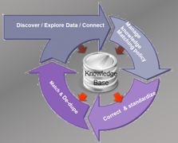
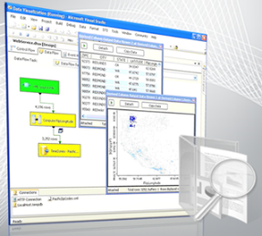
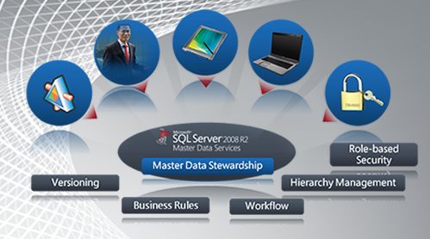
Use Case: Enterprise Information Management
Integration Services
Master Data Services
Data Quality Services
Primarily designed to implement ETL processes
Provides a robust, flexible, fast, scalable and extensible architecture
Master data management
Manages reliable, centralized data
Broadens its reach with a new Excel Add-in that can leverage Data Quality Services
Knowledge-driven data cleansing
Corrects and de-duplicates data
Integrates with Integration Services
Complete, Clean, Consistent and Current Data
Notes:
Overview: SQL_Server_2012_Enterprise_Information_Management_Whitepaper.pdf by Graeme Malcolm
Master Data Services (MDS) enables your organization to manage a trusted version of data
SQL Server Master Data Management solution first available in 2008 R2, improved in 2016
Create a (logical) data model for master data (under Shared Features)
Create validation and business rules (can be defined in Excel) with workflow
Allows for load of data from various data sources
Allows manual modification of trusted version
Versioning
Security
Notifications
Sharepoint integration
Requires:
SQL Server Database: separate instance from sources - Includes staging tables and master data tables
Web front end
Good Reading
Peter Myers End-to-End SQL Server Master Data Services - sqlSaturday393_E2E-MDS.pdf
Jeremy Kashel https://www.sqlbits.com/Sessions/Event7/end_to_end_master_data_management_with_sql_server_master_data_services
Data Quality Service (DQS) provides a knowledge-based approach to managing data quality. Allows customers to cleanse, match, standardize, and enrich data to make sure it is accurate, consistent, and complete

Slide 8
Master Data Services (MDS) Overview
Enables your organization to manage a trusted version of data. SQL Server MDS solution first available in 2008 R2, improved in 2016
Create a (logical) data model for master data (under Shared Features)
Create validation and business rules (can be defined in Excel) with workflow
Allows for load of data from various data sources
Allows manual modification of trusted version
Versioning
Security
Notifications
Sharepoint integration
Requires:
SQL Server Database: separate instance from sources - Includes staging tables and master data tables
Web front end
Excel Plug-In

Slide 9


Demo
Notes:
Some install notes if Webservice is not starting up:
Look at Event Viewer - cmd eventvwr.msc
Services desktop app for details
Find name of server you want to use. Tried to resolve the name. If it does not resolve, modify the local lmhosts file to manually add it since Domain Name Services (DNS) does not know about it.
If using windows authentication, and windows password changes, may need to drop and recreate web service
SQL for usr views:
DECLARE @EntityName VARCHAR(25) = 'Gender'
SELECT [Name],[EntityTable]
FROM [mdm].[tblEntity]
WHERE [Name] LIKE '%'+ @EntityName +'%'
SELECT [tblAttribute].[DisplayName]
,[tblAttribute].[TableColumn]
,[tblEntity].[Name] AS [EntityName]
FROM [mdm].[tblAttribute]
INNER JOIN [mdm].[tblEntity]
ON [tblEntity].[ID] = [tblAttribute].[Entity_ID]
WHERE [tblEntity].[Name] LIKE '%'+ @EntityName +'%'

Slide 10




MDM Architectures
Transactional Source Systems
ODS
Data Warehouse
BI & Analytics
Hub
OLTP
Reporting
Dashboards
ERP
CRM
Historical
Centralized | Distributed
Hub | Registry
Repository | Federated
Predictive Analytics
Notes:
http://www.jamesserra.com/archive/2013/01/master-data-management-mdm-hub-architecture/
https://msdn.microsoft.com/en-us/library/bb410798.aspx
Hub/Repository vs Registry/Federated vs Hybrid
Slide is a modification of Microsoft Slide that is found in several presentations : https://mva.microsoft.com/en-US/training-courses/big-data-analytics-with-hdinsight-hadoop-on-azure-10551?l=WZjfYu97_7404984382

Slide 11


Three Ways – Mutually Exclusive
Three Ways to Master Data
Mutually Exclusive
Vertically Fragmented
Match and Merge
Mutually Exclusive Using MDS
Gather list
Upload to MDS
Repeat
Engineering Classes
Master Class List
Math Classes
Philosophy Classes
Notes:
Mastering is always about having disparate sources of data and brining it together. Three types of mastering:
Mutually exclusive – the data is different sources but there is no overlap. Mastering brings the sources into a single ‘list’ with a common structure. Example: class list across departments, vendor contract data
Vertically fragmented – the data is in different sources and there are attributes of the data that are different in these sources. Mastering creates a single view of the data that appears as if all attributes are in one master record. It is important to identify the source of the data by attribute in this type of mastering. Only one application can create a new record. However, different applications may be able to update – but only the attributes they are the source for. Example: most likely the plan list.
Match and merge – the data is in different sources and there is overlap of both rows of data and attributes within the data. Therefore, to master the data and provide a single view a complicated set of understanding the sources and attributes, ranking the owner, and recognizing the same information that arrives from those sources differently. These are the match and merge rules. Example: Provider data master.
Why Do MDM
Portal
Provides single logical view of data that is consistent and trustworthy information
Users see same data consistently across all applications and all plan
Efficiency
Reduces overhead
Integrate data
Compliance
Facilitates industry pressures and government mandates
Allows data integrity for data object
Reuse - Expedites computing in multiple systems, architectures, platforms and applications
Scalability - Support the projected growth

Slide 12
Three Ways – Vertically Fragmented
Three Ways to Master Data
Mutually Exclusive
Vertically Fragmented
Match and Merge
tCustomer
Customer Config
Sales Customer Data
Master Plan List
Vertically Fragmented Using MDS
Determine attributes needed
Pre-join sets
Upload to MDS
Notes:
Mastering is always about having disparate sources of data and brining it together. Three types of mastering:
Mutually exclusive – the data is different sources but there is no overlap. Mastering brings the sources into a single ‘list’ with a common structure. Example: class list across departments, vendor contract data
Vertically fragmented – the data is in different sources and there are attributes of the data that are different in these sources. Mastering creates a single view of the data that appears as if all attributes are in one master record. It is important to identify the source of the data by attribute in this type of mastering. Only one application can create a new record. However, different applications may be able to update – but only the attributes they are the source for. Example: most likely the plan list.
Match and merge – the data is in different sources and there is overlap of both rows of data and attributes within the data. Therefore, to master the data and provide a single view a complicated set of understanding the sources and attributes, ranking the owner, and recognizing the same information that arrives from those sources differently. These are the match and merge rules. Example: Provider data master.
Why Do MDM
Portal
Provides single logical view of data that is consistent and trustworthy information
Users see same data consistently across all applications and all plan
Efficiency
Reduces overhead
Integrate data
Compliance
Facilitates industry pressures and government mandates
Allows data integrity for data object
Reuse - Expedites computing in multiple systems, architectures, platforms and applications
Scalability - Support the projected growth

Slide 13
Three Ways – Match and Merge
Match and Merge Using MDS
Does not work
Three Ways to Master Data
Mutually Exclusive
Vertically Fragmented
Match and Merge
Name: S. Snape
SSN: 123-45-6789
Degree: Engineering
Name: Prof. Severus Snape
SSN: 123-45-6789
Emp Id: 456
Address: 9 Galen St
Phone: 617-555-1212
Degree: Engineering
Name: Prof. Snape
Emp Id: 456
Phone: 617-555-1212
Name: Severus Snape
SSN: 123-45-6789
Address: 9 Galen St
Phone: 617-555-1212
Notes:
Mastering is always about having disparate sources of data and brining it together. Three types of mastering:
Mutually exclusive – the data is different sources but there is no overlap. Mastering brings the sources into a single ‘list’ with a common structure. Example: class list across departments, vendor contract data
Vertically fragmented – the data is in different sources and there are attributes of the data that are different in these sources. Mastering creates a single view of the data that appears as if all attributes are in one master record. It is important to identify the source of the data by attribute in this type of mastering. Only one application can create a new record. However, different applications may be able to update – but only the attributes they are the source for. Example: most likely the plan list.
Match and merge – the data is in different sources and there is overlap of both rows of data and attributes within the data. Therefore, to master the data and provide a single view a complicated set of understanding the sources and attributes, ranking the owner, and recognizing the same information that arrives from those sources differently. These are the match and merge rules. Example: Provider data master.
Why Do MDM
Portal
Provides single logical view of data that is consistent and trustworthy information
Users see same data consistently across all applications and all plan
Efficiency
Reduces overhead
Integrate data
Compliance
Facilitates industry pressures and government mandates
Allows data integrity for data object
Reuse - Expedites computing in multiple systems, architectures, platforms and applications
Scalability - Support the projected growth

Slide 14
Types of Dimensions
Class | Type | Description | History
Slowly Changing (SCD) | 1 | Overwrite. New record replaces existing record | No
Slowly Changing (SCD) | 2 | New record is added. Records must have start and end dates. | Yes
Slowly Changing (SCD) | 3 | Record is modified with additional attribute. Records effective dated. | No
Slowly Changing (SCD) | 4 | Stored in two tables, current and history table. Supported by temporal tables. | Yes
Slowly Changing (SCD) | 6 | Hybrid | Yes
Rapidly Changing (RCD) |  | Data arriving regularly and frequent updates May be mastered and/or handled as late arriving Frequently, the star schema revolves around these dimensions Ex. Customer, Distribution Channel, Product | Yes
Notes:
http://www.kimballgroup.com/2008/08/slowly-changing-dimensions/
http://www.kimballgroup.com/2008/09/slowly-changing-dimensions-part-2/

Slide 15

Driving to the Golden Copy
Pick a driving system
Determine a third party source
Assign Confidence levels

Slide 16
Mastering Backlog
Entity | Systems Used | Type | Driver | Approach | Data Model | Metadata Quality | Mastered | Governed | Priority
Gender |  | SCD |  | Manual
US States |  | SCD |  | Manual
Language |  |  |  | Vertically Fragmented
Chanel Partners |  |  | Internal | Vertically Fragmented
Professors |  | SCD | Internal | Vertically Fragmented
Providers |  | SCD | NPI | Vertically Fragmented
Timezone Offsets |  |  | External | Manual
Customer |  | RCD |  | Mutually Exclusive or Match/Merge
Customer Status |  | SCD |  | Vertically Fragmented

Slide 17
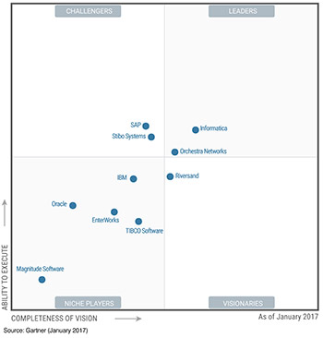
Gartner Master Data Management
Many Vendors
Informatica
IBM Infosphere/Initiate
SAP
Oracle
SQL Server
Talend
TIBCO
Notes:
https://www.gartner.com/doc/3575817/magic-quadrant-master-data-management

Slide 18
Resources
Peter Myers
End-to-End SQL Server Master Data Services - sqlSaturday393_E2E-MDS.pdf
https://www.edx.org/course/creating-master-data-solution-sql-server-microsoft-dat226x
https://www.edx.org/course/data-cleansing-data-quality-services-dqs-microsoft-dat218x-1
Jeremy Kashel https://www.sqlbits.com/Sessions/Event7/end_to_end_master_data_management_with_sql_server_master_data_services
Matt Masson
https://www.mattmasson.com/2012/03/getting-started-with-dqs-and-mds/
Steve Simon
http://www.sqlsaturday.com/647/Sessions/Details.aspx?sid=67436
Siddharth Mehta
https://www.mssqltips.com/sqlservertutorial/3800/sql-server-master-data-services-overview/

Slide 19
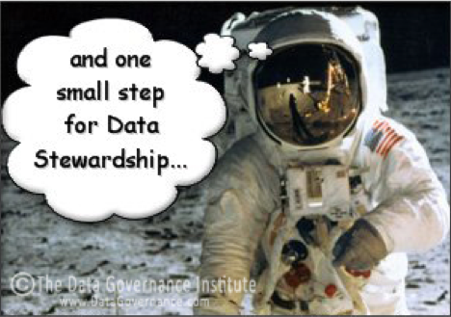
Thank you.
We appreciate your interest, and look forward to working with you in the future!
Nice report. Now can you add ….
Beth Wolfset
beth.wolfset@insight.com
Twitter: @beth_wolfset

Slide 20
Data Quality Services (DQS) Overview
Features
Create a knowledge-based approach
Managing data quality
Cleanse, match, standardize, and enrich data
Map to domains
Requires:
SQL Server Databases: separate instance from sources - Includes staging and knowledge base
Local Client front-end
Excel Plug-In

